Slide 1

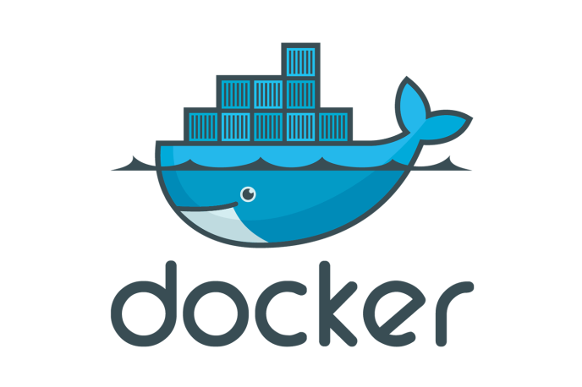
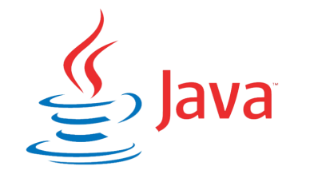
Introduction to Docker for Java Developers
Use Case Based Problem-Solution Approach to learning

Slide 2



Who should take this course?
Java Developers
Dev OPS Engineers and Engineering Managers
Students, College grads

Slide 3
What are you going to learn?
Quick Introduction to Docker Fundamentals on how to Build->Ship->Run Software using Docker with a ton of real life use cases

Slide 4


Use case 1 : Apache httpd
Goal: Host a website of pictolearn on multiple Docker containers running on the same host machine using the httpd server
Container – 1
Container -2
What you will learn?
Building a custom image from Dockerfile.
Running multiple containers out of an image with your website hosted on it.
Docker CLI Commands (All important commands required to form the foundation of understanding Docker)
Host Operating System (Windows, MAC OSX, Linux)
Docker Engine
Infrastructure / Server
Introduction to Docker for Java Developers

Slide 5

Use case 2 : NGINX
Goal: Host a website of pictolearn on multiple Docker containers running on the same host machine using the NGINX HTTP server
Container – 1
Container -2
What you will learn?
Running multiple containers using NGINX
Pushing the image to Docker Hub
Pulling the image from Docker Hub
The Real Build - > Ship - > Run use case
Host Operating System (Windows, MAC OSX, Linux)
Docker Engine
Infrastructure / Server
Introduction to Docker for Java Developers

Slide 6

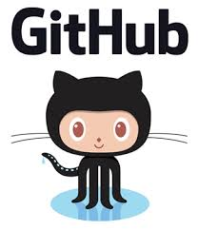

Use case 3: Docker – Git Integration
Building a Custom UBUNTU IMAGE
JDK 1.8, VI editor, mysql client, MAVEN
UBUNTU 16.04
Host Operating System (Windows, MAC OSX, Linux)
Docker Engine
Infrastructure / Server
Introduction to Docker for Java Developers

Slide 7


Use case 4: Deploy a war to Tomcat
Spring WAR application
TOMCAT 8.0
Host Operating System (Windows, MAC OSX, Linux)
Docker Engine
Infrastructure / Server
Introduction to Docker for Java Developers

Slide 8





Use case 5 and Use Case 6
Spring WAR application running on JDK 7 and Tomcat 7
Spring WAR application running on JDK 8 and Tomcat 8
Ubuntu 16.04 Image with Tomcat 7 and JDK 7
Ubuntu Image with Tomcat 8 and JDK 8
Host Operating System (Windows, MAC OSX, Linux)
Docker Engine
Infrastructure / Server
Introduction to Docker for Java Developers

Slide 9
Use case 7: Mounting Volumes
Spring WAR application running on JDK 7 and Tomcat 7
Goal:
Mount the logs of the war file running in the container to the local hard drive.
Ubuntu 16.04 Image with Tomcat 7 and JDK 7
Host Operating System (Windows, MAC OSX, Linux)
Infrastructure / Server
Docker Engine
Introduction to Docker for Java Developers

Slide 10
Use case 8: Microservices with docker-machine and docker-compose
Virtual Host 1
IP: 172.0.0.1
Virtual Host 2
IP: 172.0.0.2
Container-1 MYSQL
Container-2 Java
Container-1 MYSQL
Container-2 Java
Host Operating System (Windows, MAC OSX, Linux)
Docker Engine
Infrastructure / Server
Introduction to Docker for Java Developers

Slide 11


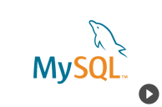
Use case 9: RESTful Microservices with Spring Boot and Hibernate
Goal: To know how to deploy a RESTful client running on Spring Boot with Hibernate and its interaction with MYSQL
Container-2 : web
Container-1 MYSQL
RESTFul Services
Host Operating System (Windows, MAC OSX, Linux)
Docker Engine
Infrastructure / Server
Introduction to Docker for Java Developers

Slide 12



Use case 10: Scaling up Microservices with docker-compose
Goal: To scale up microservices with docker compose
Container-2 : web
Container-3: web
Router
Host Operating System (Windows, MAC OSX, Linux)
Docker Engine
Infrastructure / Server
Container-1 MYSQL
RESTFul Client
Introduction to Docker for Java Developers

Slide 13

Hope to see you in the course

